Slide 1
Flexible Connection Agreements (FCA)
Schlussfolgerungen und Empfehlungen
Vordenkwerk Industrietransformation
3. September 2026

Slide 2
Key messages from RAP's Flex-to-connect Paper
FCAs can unlock constrained capacity, but because grid companies hold structural leverage over applicants, FCA frameworks need clear regulatory safeguards.
1
2
3
4
5
Set binding minimum terms
Strengthen NRA oversight
Develop rules with stakeholders
Monitor FCA use in practice
Plan FCAs as part of a wider toolkit
Define the minimum conditions every FCA must respect so applicants can assess their operational and financial exposure.
FCA frameworks should not be left largely to grid companies with limited regulatory oversight
Consult supply, large demand and storage users to reflect operational realities
Track how FCAs are used in practice and whether grid access restrictions go beyond what is necessary for grid security
Coordinate them with grid planning, cost-reflective tariffs, RES support and locally procured flexibility.

Slide 3
What are flexible connection agreements (FCAs)?
Grid access is no longer only “yes” or “no”
Traditional firm connection
+ 24/7 grid access
- 5-8 years wait
Flexible connection
+ earlier connection
- non-firm
Hosting Capacity
Power
Not allowed
Firm
Connection
User Demand
Time

Slide 4
FCAs turn “not allowed” into “connect with conditions”
Grid access is no longer only “yes” or “no”
Traditional firm connection
+ 24/7 grid access
- 5-8 years wait
Flexible connection
+ earlier connection
- non-firm
Hosting Capacity
Power
Restricted
Flexible
Connection
User Demand
Time

Slide 5
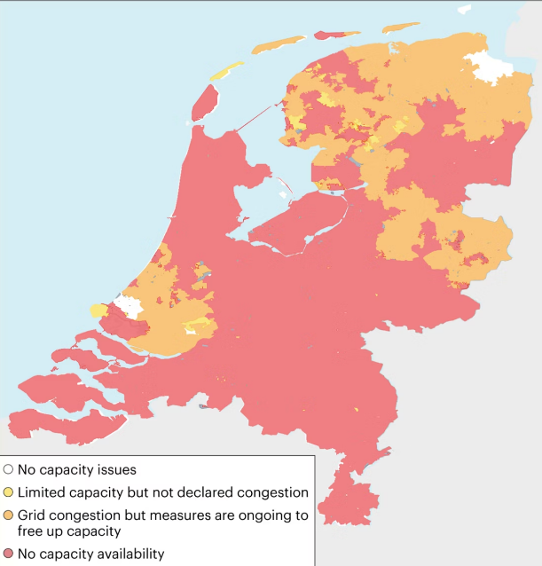
Why have FCAs emerged?
Grid connection capacity available for consumption in the Netherlands, October 2024
Grid reinforcement cannot keep pace with connection demand - while usable capacity can remain available outside peak periods.
Connection queues relative to 2024 peak load
Italy
Netherlands
Germany
12x
6x
4x
Source: IEA (2025), Grid congestion is posing challenges for energy security and transitions.

Slide 6
What FCAs are designed to achieve
Problem: connecting every project on a fully firm basis is increasingly slow, costly and sometimes not immediately possible.
FCAs have a dual purpose:
Wider system goal:
Speed up connection in congested areas - sometimes making connection possible at all
Manage congestion contractually during constrained periods
Enable more renewables and storage, and aid electrification
Avoid unnecessary reinforcement where flexibility is the cheaper solution

Slide 7

FCA design must balance predictability with operational flexibility
Investment certainty for users and operational security for the grid must be designed together
Market reality
clear operational boundaries
worst-case scenario clarity
business-case predictability
ability to respond to market signals
Grid reality
system stability & reliability
predictable grid conditions
stress-test compliance
operational control during constraints

Slide 8
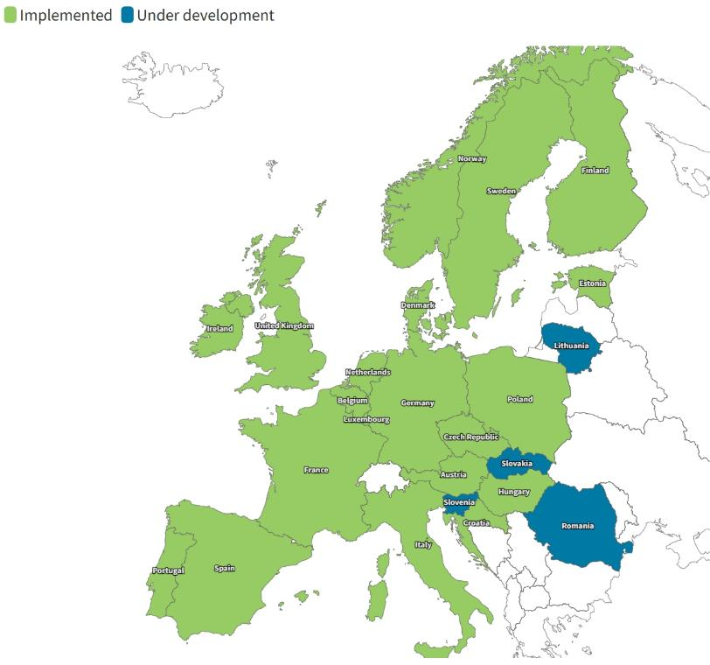
EU countries with national FCA rules in place
20 European countries have national FCA rules; five more are developing rules.
17/20
cover supply
12/20
cover demand
16/20
cover storage
FCA rules differ widely by governance, users covered and design detail.
Notes:
The map shows countries with national FCA rules in place. 20 EU countries have national FCA rules in place, whereas 5 more EU countries are developing those (LT, MT, RO, SK, SI)

Slide 9
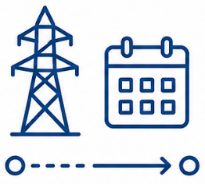


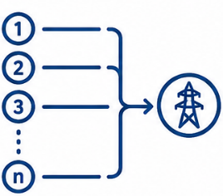


The FCA design elements
The design elements decide whether an applicant has enough certainty to accept an FCA.
1 Agreement duration
2 Grid use restrictions
3 Financial implications
4 Stakeholder consultation
Temporary or permanent, and when it turns firm
Firm capacity, limits, notice and sequencing
Reduced network tariffs or connection charges
Who designs the rules, and with whom
5 Transparency
6 Queue management
7 Reporting and monitoring
8 System-level oversight
Published FCA types, locations and response times
How FCA requests are ranked and converted to firm
Volumes, restrictions and system-level impact
Cumulative interaction with tariffs and local flexibility

Slide 10
Recommendations by design element (1/2)
Design element | Recommendation | Country examples
Agreement duration | Set binding timelines for converting temporary FCAs to firm access. Permanent FCAs need NRA prior approval and periodic review. | AT: 12 / 18 / 24 months by voltage level PL: max. 3 years after completion
Grid use restrictions | Apply restrictions only as a last resort. Define firm capacity, restriction limits, notice timing and sequencing up front. | FR: 70% firm capacity floor NL: access in 85% of annual hours PT: last-in, first-out
Financial implications | Discounts must reflect real avoided grid costs. Publish the methodology, make it auditable and review it periodically. | 11 countries offer reductions FR, PT, FI: earlier connection is the benefit
Stakeholder consultation | NRA-led, with supply, large demand and storage involved, and a transparent record of how feedback shaped the design. | SE, EE, NO: binding consultation duties SE: documents non-discrimination

Slide 11
Recommendations by design element (2/2)
Design element | Recommendation | Country examples
Transparency | Publish which FCA types are offered and how to request one - not buried in general terms - with a binding deadline to answer requests. | EE & DK: the only countries publishing FCA connection locations
Queue management | Set clear ranking rules, safeguards against speculative applications, and the treatment of FCA holders once reinforcement is delivered. | DE: ~700 GW storage queue, maturity ranking introduced NO: FCA users re-enter the queue
Reporting & monitoring | Require regular reporting on FCA volumes, restriction frequency and capacity, and any tariff or charge reductions granted. | FR: annual reports plus network-level caps ES: annual reporting on effective use
System-level oversight | Assess the cumulative impact of FCAs - their interaction with dynamic tariffs, local flexibility and RES support is still uncertain.

Slide 12
Lesson from Europe for Germany
FCA can solve specific grid connection problems, but can’t solve the locational operation challenge
FCAs can
Prioritisation criteria for grid connection
bridge to market-based time-varying and local pricing and such grid fees – FCA aren’t a substitute for these
provide system operator needs / back-up for security of supply
make grid connections feasible
… if designed and regulated accordingly
social and/or security/defending needs first
existing customers ahead of new customers which are flexible about the location
marked based allocation within same group (auction) and connection point
status of project development instead of first-come-first-serve

Slide 13
Thank you!

Slide 14
Andreas Jahn
ajahn@raponline.org

