Slide 1
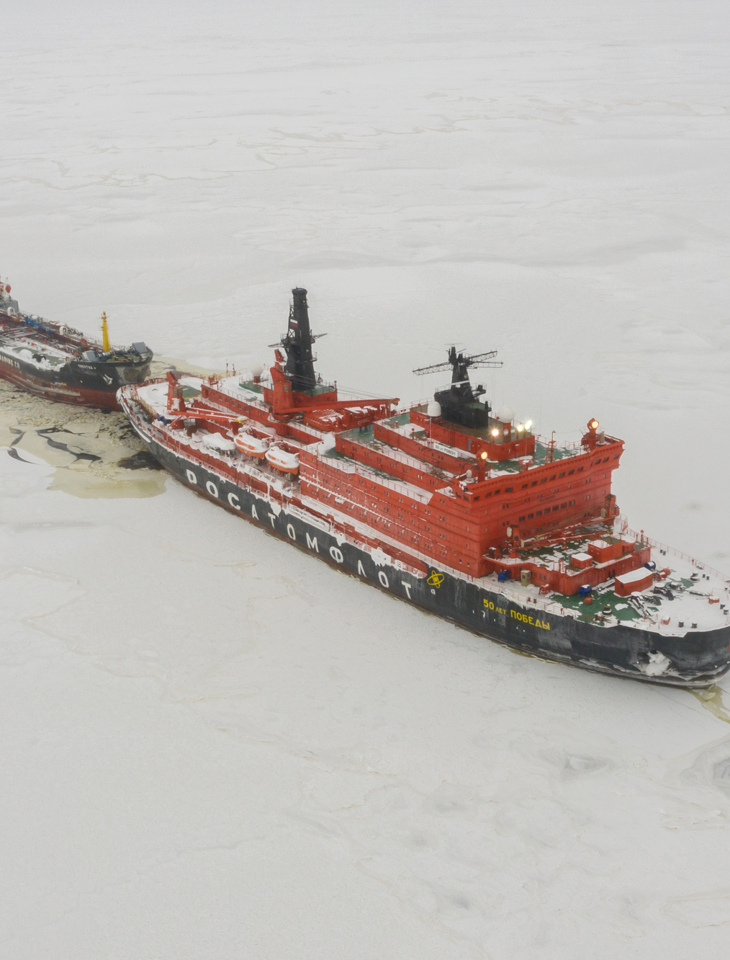
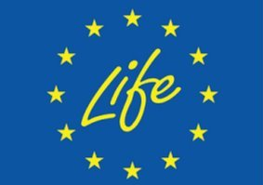
The Northern Sea Route reality check: Shorter, safer, cheaper, environmentally friendly, and popular?
Ksenia Vakhrusheva
Bellona Environmental Transparency Center - etc.bellona.org

Slide 2
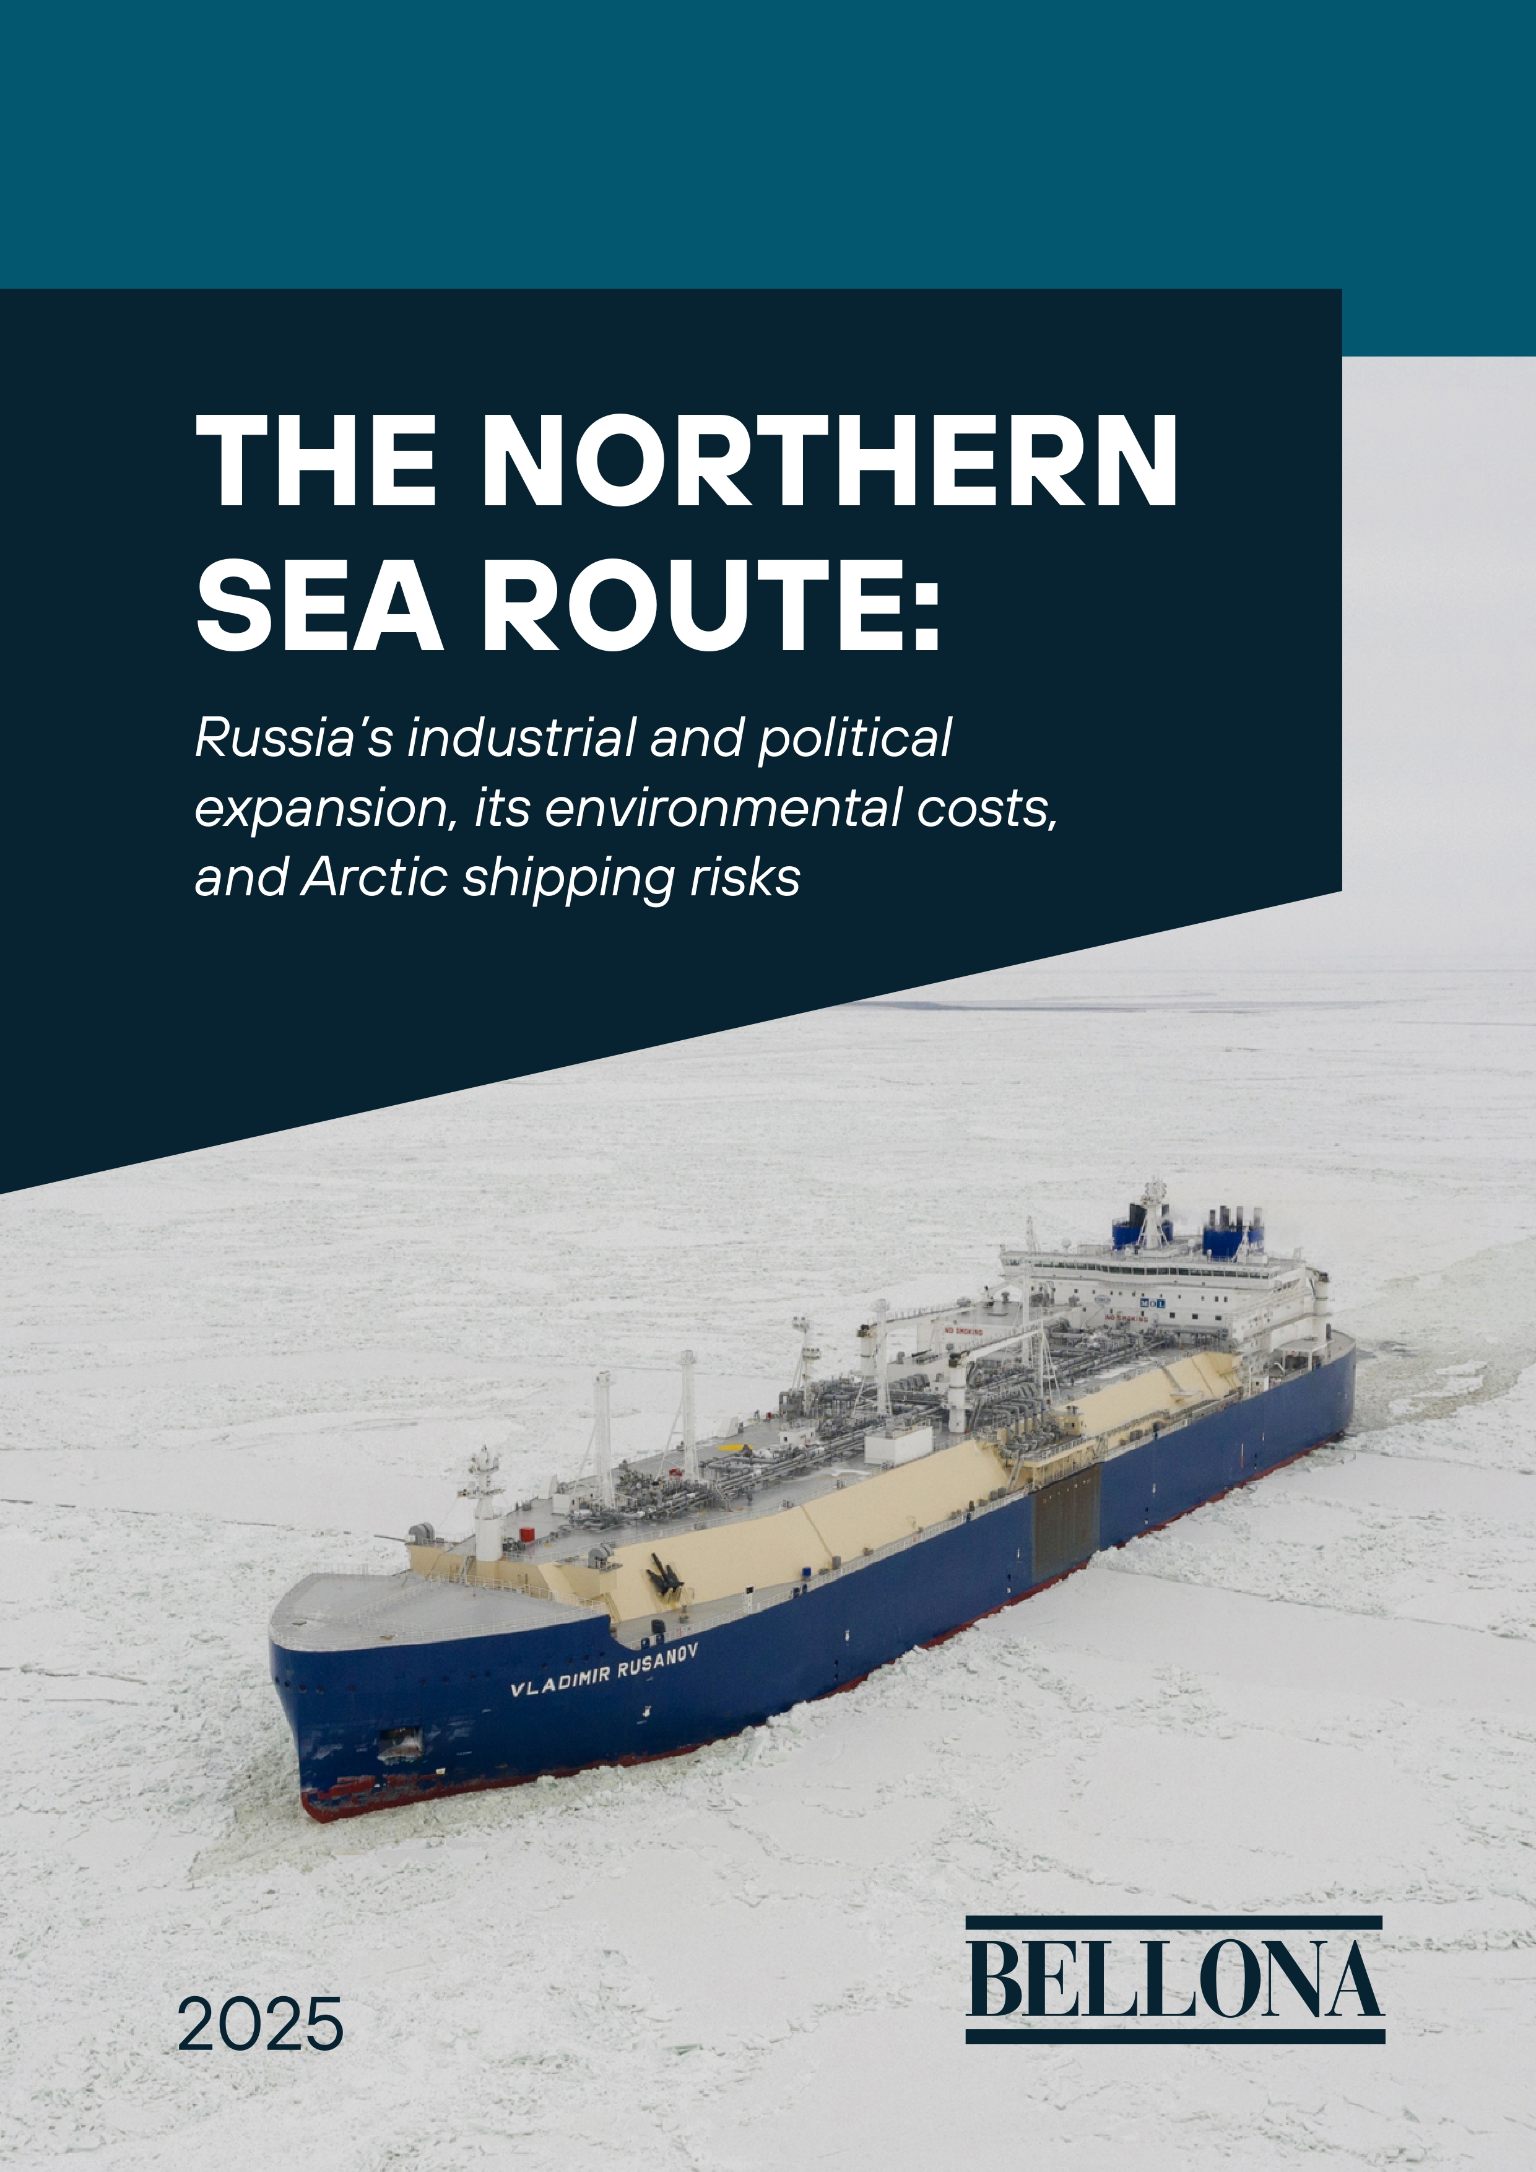

Bellona's report
Bellona Environmental Transparency Center, based in Vilnius, is an investigative group within the Bellona Foundation that operates as an independent non-profit solution-oriented environmental NGO.
Our team monitors and analyses Russia’s environmental impact within and across borders with a special focus on the environmental consequences of the Russian invasion of Ukraine, nuclear and radiation safety and security, as well as climate change and industrial pollution of the Arctic.
Reports:

Slide 3
False narrative 1: The NSR will benefit the world through faster and cheaper shipping
In reality:
Faster only by distance
Unexpected challenges (ice traps and sever weather, waiting time for help – a week and more)
Higher costs to comply with Polar code, future costs for polar fuels, higher fuel consumption
Perspectives of the all-year navigation only with icebreakers
Fully controlled by Russia, unexpected restrictions and hybrid threats

Slide 4
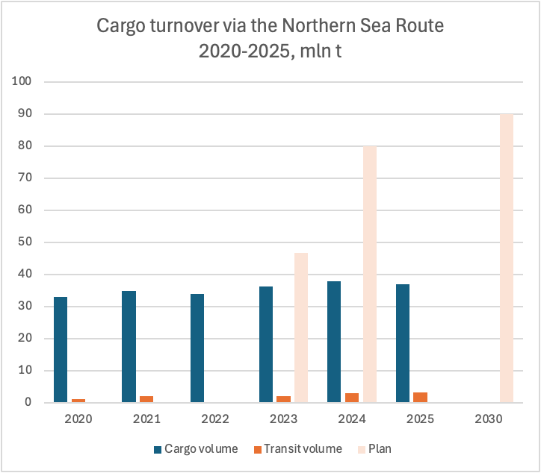
NSR cargo turnover vs plans
Russian war against Ukraine and international sanctions interfered with Russian plans to increase cargo turnover (successful sanctions to delay Arctic LNG 2 and Vostok oil projects)
84% of cargo is Arctic mineral resources shipped for export
85% of cargo is oil and gas.
100 or one third of cargo ships on NSR in 2025 are Russian shadow fleet
Planned cargo: + 40 mln t LNG, + 100 mln t oil
Transit:
Most transit is export of oil from Russia to China
One international transit in 2025 (China-Europe), one is announced for 2026 (South Korea-Europe)
Plan for transit volume is 10 mln t by 2035

Slide 5
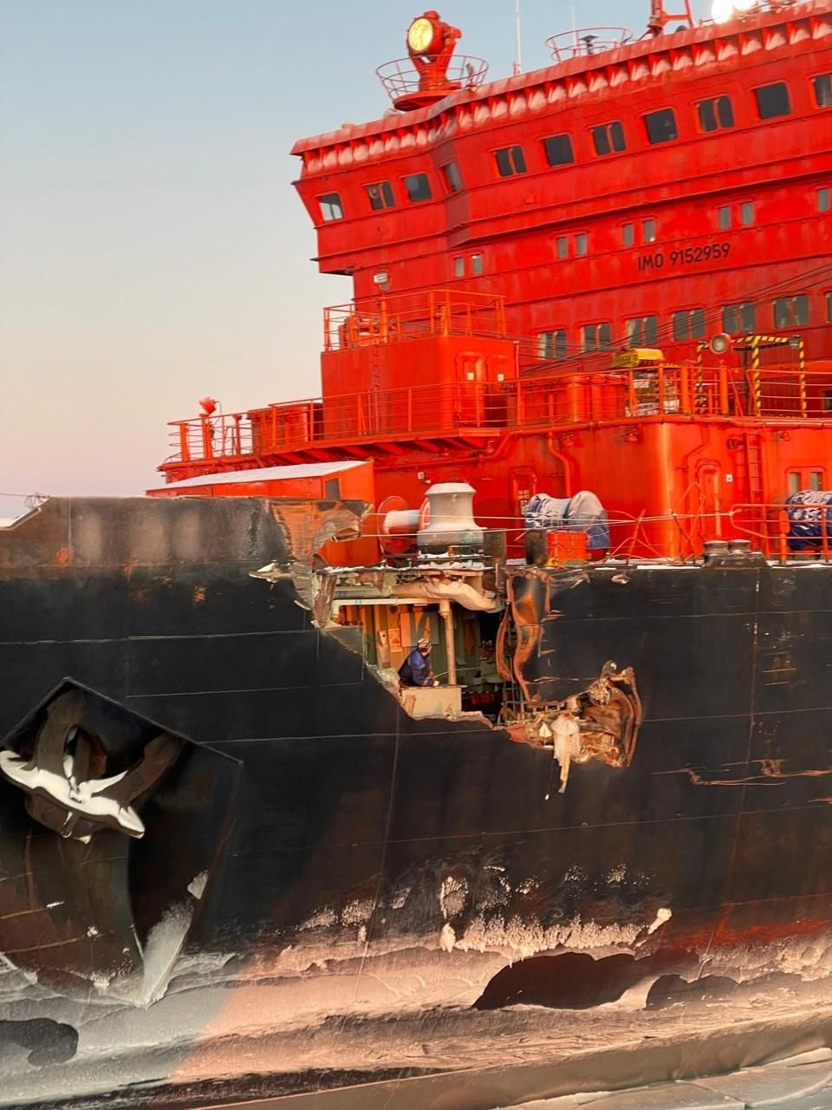
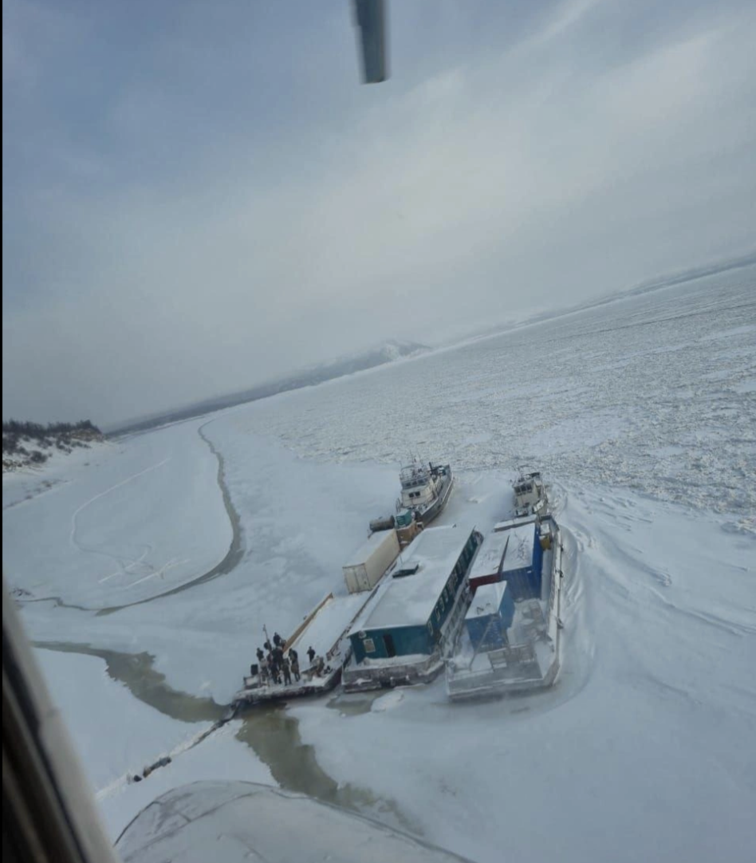
Insidents on NSR
Rosatom (NSR Administration unit) stopped including incidents statistics in its annual report.
In 2025:
Сollision between nuclear icebreaker 50 years of victory and cargo vessel Yamal Krechet - 26.01.2025
Explosion on oil tanker Onemen near Anadyr, no spill as reported – Aug.25
Oil tanker Lynx and gas tanker Arctic Metagas (both no ice class) met sea ice in the Eastern-Siberian sea (+ one week to a voyage) – Aug-Sept.25
Gas tanker Buran and Voshod (both Arc4) seek passage through ice for a week in Oct-Nov.25 and then used icebreaker assistance. Buran didn't get to Arctic LNG 2 terminal even with icebreaker assistance in Dec.25
Cargo vessels Ostrov Antsiferova and FESCO Moneron couldn't get to port in Anadyr for more than a week in Oct-Nov.25
Every year ships get frozen in the Lena river if they did not manage to reach ports on time and left there until spring.

Slide 6
False narrative 2: Only Russia possesses the tools and technology to develop it safely
In reality:
Underfinancing and consequent delays in building ships, including icebreakers, SAR and pollution response vessels, cargo vessels with high ice class
Poor SAR infrastructure, esp. on the Eastern part of NSR
No available technology to clean up oil spill in Arctic waters timely and efficiently
Russia does not have technology and resources to adequately response major accidents with nuclear vessels, ex. in case of sinking
Russia tries to attract Chinese and other Asian financing to the NSR infrastructure

Slide 7
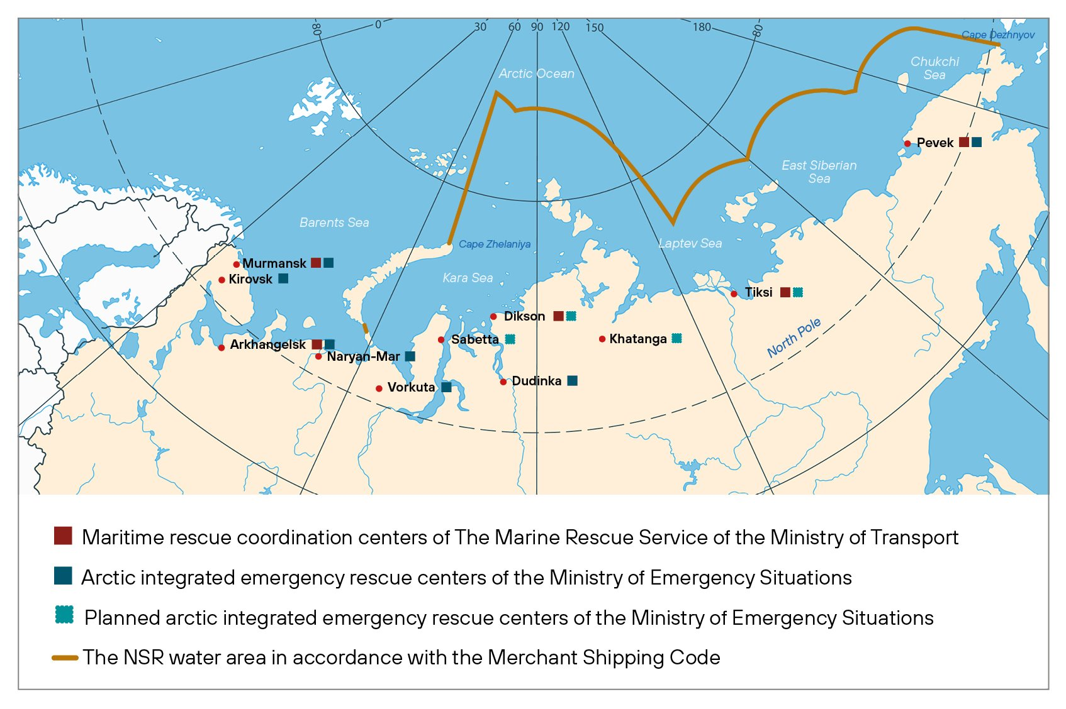
Rescue infrastracture: "we practically do not have it"
(Aysen Nikolaev, head of Saha, 2025)
Plan:
10 new Arctic rescue centers, to be completed by 2015.
46 new SAR vessels by 2030.
Current status – major delays:
3 new centers (Naryan-Mar, Arkhangelsk, Murmansk) plus 1 SAR unit in Dudinka, center in Sabetta should be opened in 2026.
13 SAR ships work on NSR (home ports are Murmansk, Arkhangelsk, Petropavlovsk-Kamchatsky). 11 SAR ships ordered.

Slide 8
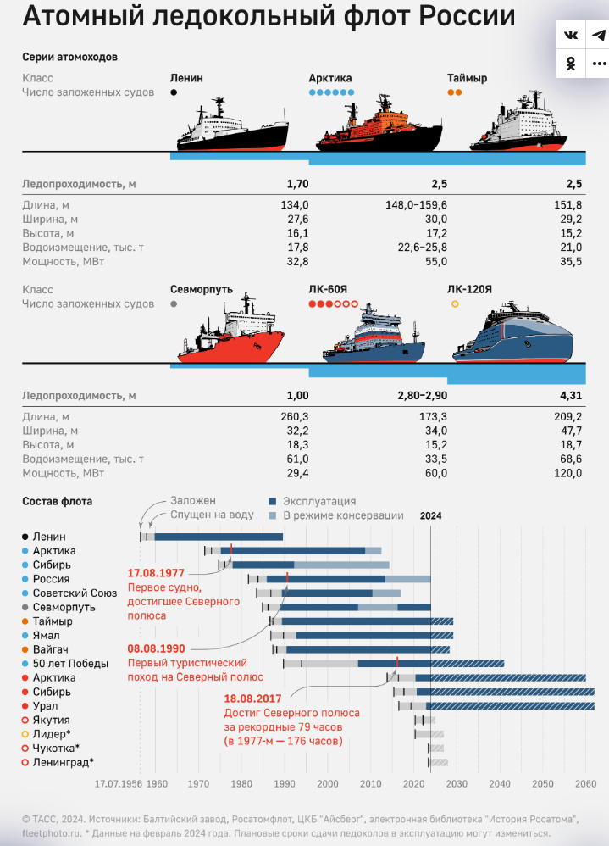
Nuclear icebreakers – expensive hope for year-round navigation
2026. 8 Icebreakers + сargo vessel:
End of cooperation with Western suppliers, particularly from Finland, loss of Ukrainian supplier - NKMZ in Kramatorsk (formerly Rosatom’s plant), sabotage and disruption of supply chains led to delays
Reduced plans (one 10510 icebreaker instead of 3), less state funding, seeking for extra resources for building icebreakers. Assistance fee on NSR does not fully cover building costs.
Increasing costs (Leningrad and Stalingrad are almost twice as expensive as Arktika and likely their costs will be increased by 30% or more)
No technology and capacity to respond to major accidents with nuclear vessels (ex. in case of sinking)
Sevmorput (1988)
(ice-class cargo vessel )
Taymyr (1989)
Vaygaсh (1990)
Yamal (1992)
50 Let Pobedy (2007)
Not in use, likely to be decommissioned
by 2030
Arktika (2020)
Sibir (2022)
Ural (2022)
Yakutia (2024)
2030-2035. 9 Nuclear icebreakers:
50 Let Pobedy (2007)
Arktika (2020)
Sibir (2022)
Ural (2022)
Yakutia (2024)
+4 new
Chukotka (2026)
Leningrad (2028)
Stalingrad (2030)
Rossiya (2030?)
Bellona infographics

Slide 9
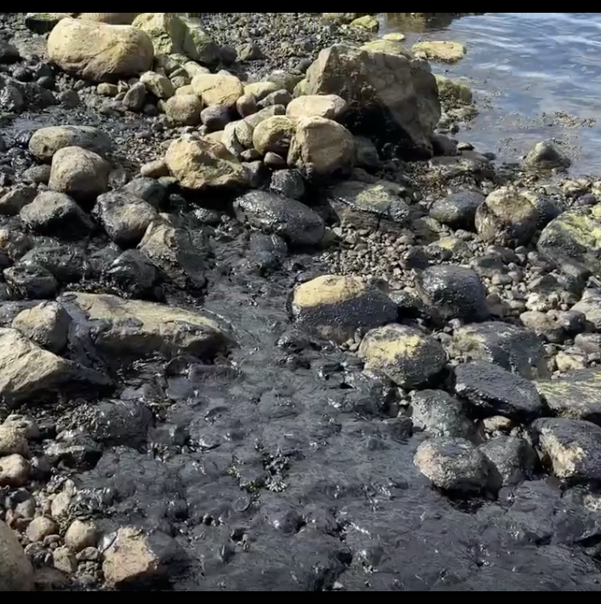
How spills are (not)cleaned up in the Russian Arctic
June.25, Murmansk region – small ship ran aground and spilled fuel. No clean up. After a week authorities ordered the owner to remove the ship.
Sept.25, Murmansk region – oil spill found in the Kola bay, source not found. Authorities reported successful clean up just before the swimming competition.
March.25, Saha – diesel spill on Yane river, a company at fault reported it and started cleaning.
Apr.24, Murmansk region – sunken ship, fuel spilled. Sorbent and booms were applied the next day.
July.24, Murmansk region – oil concentration in the sea water was 400 times higher than norms. A source wasn't found.
Aug.24, Murmansk region – activists reported oil slicks on water, no reaction from authoirities. Later the same month HFO spill while bunkering in port. In September criminal case opened, before that – no clean up.
Oct.24, Krasnoyarsk region – oil spill from a barge in the Khatanga river, reported that spill was localised.
Nov.24, Barents sea – oil spill after ship capsized, no clean up. Criminal case against the captian.

Slide 10
False narrative 3: A new multipolar world order depends on Russia asserting sovereignty in the High North
In reality:
The 2022 Maritime Doctrine names the Arctic coastal seas, the NSR and the Arctic shelf as key priority areas vital to the economy (meaning oil and gas export) and national security of Russia.
The current Russian regime aims to dominate in the Arctic regardless environmental or climate consequences.
Activities on the NSR drive similar response from the US

Slide 11
Key messages
NSR should not be seen as an inevitable path for future commercial shipping. On the contrary, it should be limited to the needs of the local population and science.
It is perfect time now for the EU to oppose commercial transit shipping via NSR, while it is almost non-existent, giving a strong signal to China and South Korea.
Stricter rules should be introduced for Arctic shipping in general.

Slide 12




Thank you!
Ksenia Vakhrusheva
Manager, Arctic Policy Advisor
BELLONA
Ksenia@bellona.org
Etc.bellona.org
+359886841706
Arctic Monthly digest:
Bellona on LinkedIn:

